Slide 1
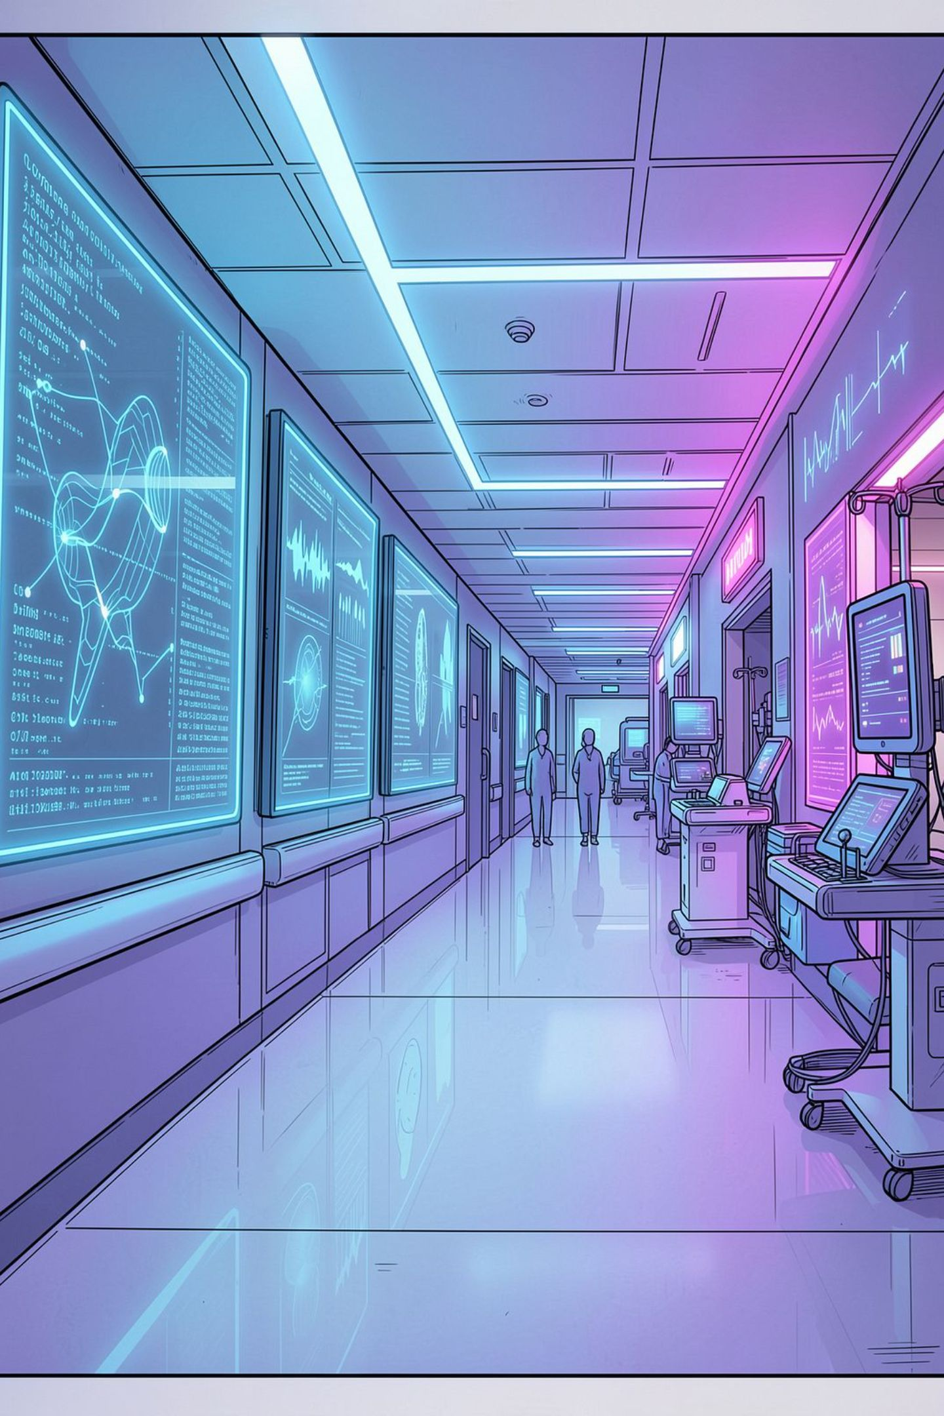
AI-Powered Prior Authorization
A Regional Health Plan Transformation Blueprint
REDUCING TURNAROUND TIME BY 40% · REDUCING REWORK · MAINTAINING CLINICAL QUALITY

Slide 2
The Scale of the Challenge
The CMO asks: "How can AI improve this process while maintaining clinical quality and regulatory compliance?"
15,000
4.2
Monthly Requests
Days Turnaround
Prior auth requests processed each month
Current average turnaround time
22%
2.5
Rework Rate
Days Target
Requests sent back for missing information
AI-augmented turnaround goal

Slide 3
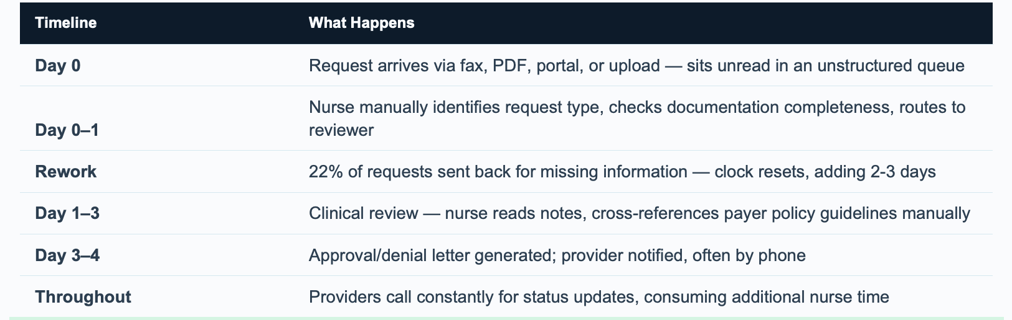
Where the 4.2 Days Actually Go
Original workflow breakdown from the solution PDF, page 2
Source: Prior Auth AI Solution, page 2. Illustrative scenario; not measured demo results.
Notes:
Original chart reproduced from page 2 of Prior_Auth_AI_Solution.pdf. Day ranges describe the hypothetical workflow; they overlap and do not provide an additive calculation proving the 4.2-day average.

Slide 4

Four-Layer AI Architecture
Intake Layer
OCR + Document AI — Fax, PDF, portal, upload converted to structured data
Intelligence Layer
Multi-Modal RAG + Clinical NLP — Completeness check, policy lookup, medical necessity analysis
Decision Support
Auto-Approval + Nurse Queue — Risk stratification routes cases to auto-approve or human review
Communication Layer
Provider Portal + Notifications — Real-time status, automated letters, missing info requests

Slide 5
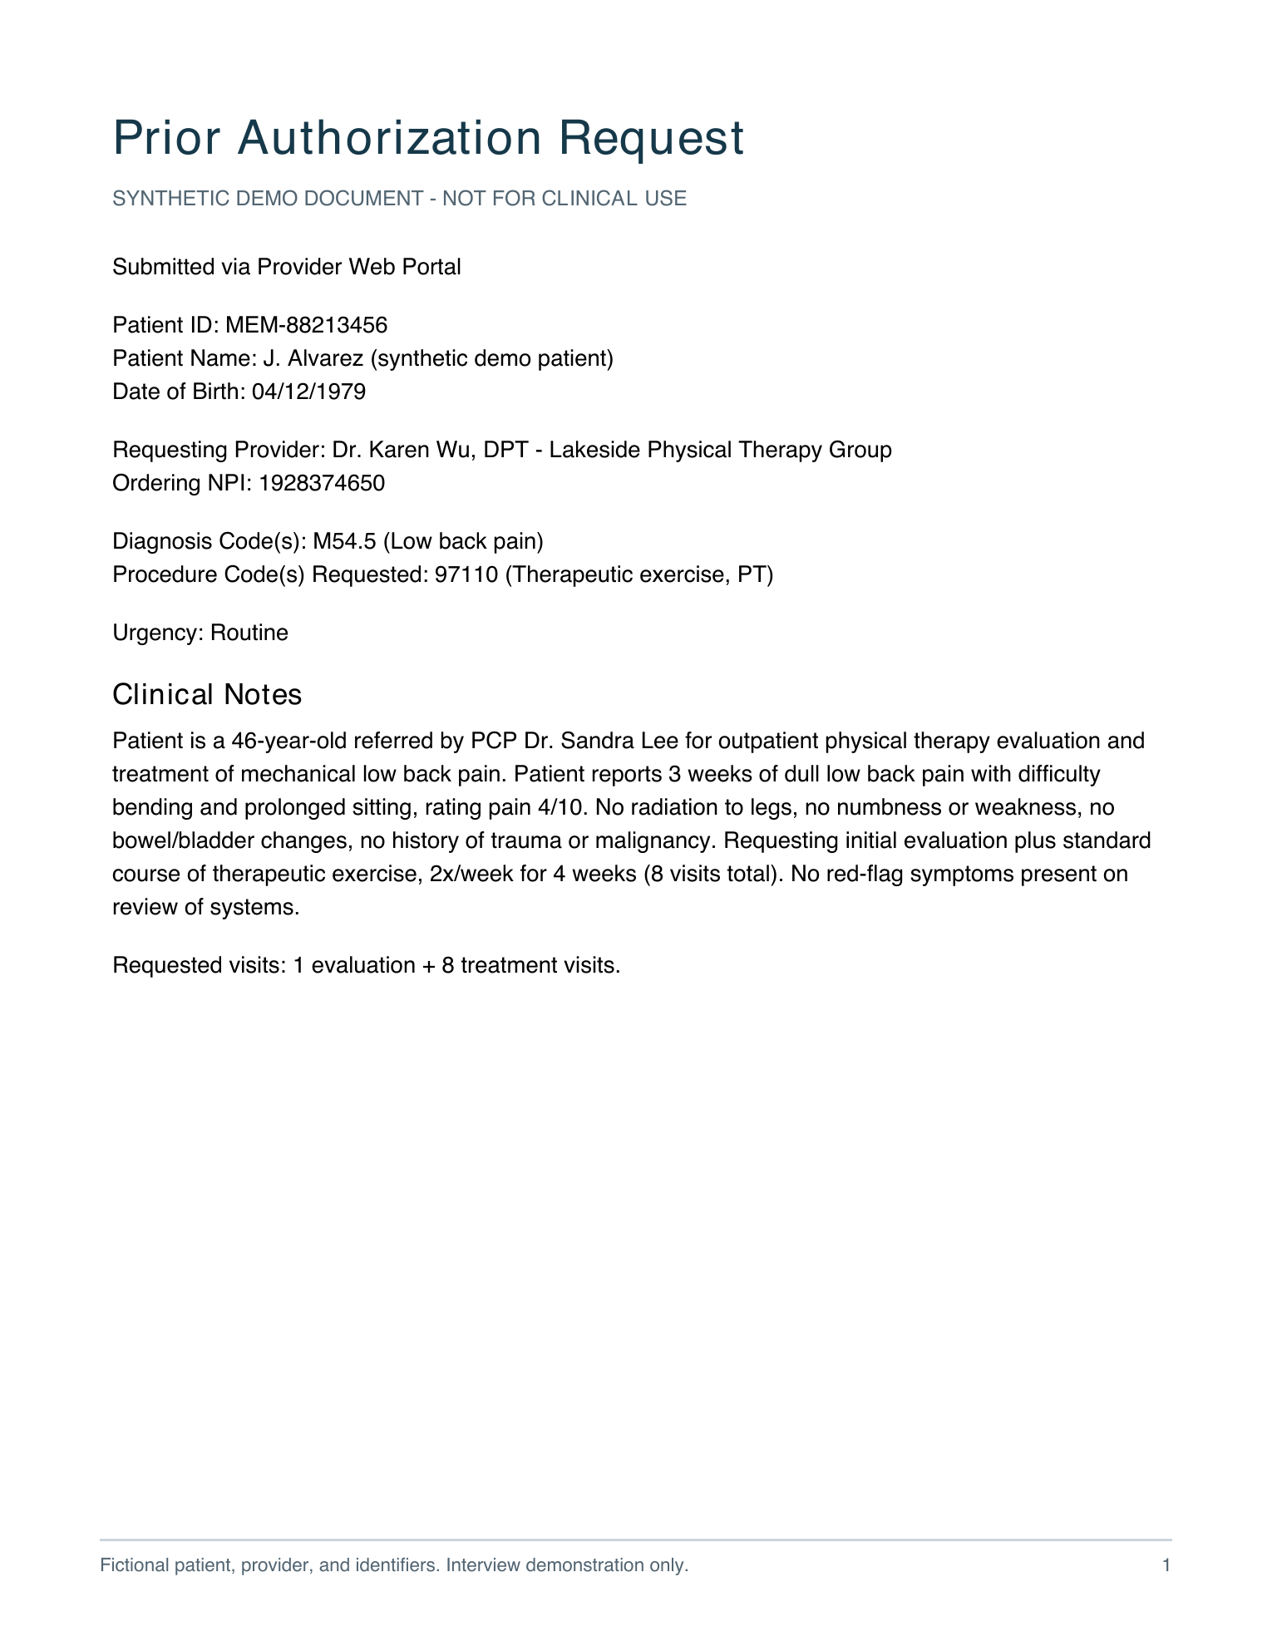
Intake Layer
Converts uploaded documents into structured request information
INPUT: SYNTHETIC REQUEST
OUTPUT: STRUCTURED FIELDS
Patient ID: MEM-88213456
Date of birth: 04/12/1979
Provider: Dr. Karen Wu, DPT
Diagnosis code: M54.5
Procedure code: 97110
Urgency: Routine
PDF text extraction or image OCR reads the document. GPT-4o-mini organizes the text into fields and clinical notes.
Illustrative fields from the sample. Demo uses pdfplumber and Tesseract; Azure integration is proposed.
Notes:
This is a before-and-after illustration based on the synthetic physical therapy sample, not a captured model response. The current demo accepts text-based PDFs and PNG/JPG images, plus pasted text and samples. Images use Tesseract; scanned PDFs have no automatic OCR fallback. All inputs then feed the shared pipeline. Azure document processing and live fax integration are not implemented. Sources: core/ocr.py, core/extraction.py, pages/1_New_Request.py, data/sample_requests/A_pt_eval_auto_approve.txt.

Slide 6
Intelligence Layer
Checks completeness, then compares the request with a matching policy
1. Completeness validator
2. Policy analysis
Required on every request
Patient ID and date of birth
Requesting provider
Diagnosis and procedure codes
Clinical notes
Match the procedure code to a synthetic policy; use keyword search if needed.
AI compares clinical notes with the policy and returns met or unmet criteria, citations, and a recommendation.
Also checks policy-required documentation, such as prior treatment for an MRI.
Missing information: generate a request letter and pause policy analysis.
Complete request: pass the analysis to decision support.
Notes:
Basic completeness is rule based. Policy documentation uses keyword-presence checks; it does not prove the requirement was clinically satisfied. For example, a note saying a program was not completed can pass the keyword check, leaving policy analysis to identify the unmet criterion. The policy knowledge base contains six fictional policies. Retrieval is exact CPT/HCPCS matching with BM25 fallback, not semantic retrieval or reranking. No automatic denial occurs here. Sources: core/completeness.py, core/policy_rag.py, core/pipeline.py, data/policy_kb/.
Why policy matching matters: Policy matching ensures that a request is evaluated against the right rules. Physical therapy and MRI requests have different documentation requirements and approval criteria. The selected policy determines what documentation the completeness validator checks, which criteria the AI analyzes, and whether automatic approval is allowed. Selecting the wrong policy could produce irrelevant documentation requests or misleading recommendations, even if all patient details were extracted correctly. Policy matching establishes the standard for everything that follows.

Slide 7
Decision Support Layer
Auto-approval requires every condition below; other cases follow review routing
Auto-approval requirements
Other routing and nurse review
1. Request passes completeness checks.
2. Matched policy permits auto-approval
and is marked low-cost.
3. AI recommends likely approval.
4. Model-reported confidence is at least 95%.
5. No unmet criteria and no risk flags.
Urgent / STAT takes priority: 4-hour target.
Fast-track: confidence ≥75%, at most one unmet criterion, no risk flags, and likely-approve or needs-review recommendation. 8-hour target.
Other complete cases: standard review, 24-hour target.
95% is reported confidence, not measured accuracy.
Nurses review evidence, then approve, deny, or request more information.
When eligible: approve without nurse action.
Configured turnaround target: 1 hour.
Notes:
All auto-approval gates must pass together. Completeness runs before routing. Urgent/STAT routing takes priority over auto-approval. The selected policy must explicitly allow auto-approval and be low-cost. Model confidence is self-reported, not calibrated evidence of accuracy. There is no automatic denial. Incomplete requests return for information. Other complete requests route for nurse review. The 35% auto-approval figure on the outcomes slide is an illustrative share-of-requests target, not model accuracy. SLA values are configured targets, not measured turnaround times. Sources: core/routing.py and core/pipeline.py.

Slide 8
Communication Layer
Gives providers request status, specific next steps, and decision letters
Provider portal
Example: incomplete MRI request
Providers and their staff select a request to see its status and assigned pathway.
The letter identifies missing patient details and treatment documentation.
Missing-information letter
Additional notes for re-validation
Decision letter download
Provider enters the additional information. The same pipeline checks the updated request again.
The portal shows the updated status. Audit events record processing and decisions.
Estimated decision time uses submission time plus the pathway target.
Notes:
The demo portal accepts additional documentation as pasted text, not a file upload. It displays status and letters but does not actually send external notifications. Estimated decision time does not account for queue position. Appeals, production access controls, bias monitoring, and regulatory compliance validation are outside the implemented demo. The audit log records processing events, selected AI outputs, and decisions, but not every prompt or complete letter output. All data and policies are synthetic. Sources: pages/3_Provider_Portal.py, core/pipeline.py, core/store.py.

Slide 9
Proposed Azure Implementation Roadmap
Indicative nine-month plan; advance through validation gates, not promised performance gains
1. Foundation
2. Intelligence
3. Controlled automation
Months 1–3 · Intake pilot
Months 4–6 · Assisted review
Months 7–9 · Expand pilot
Azure Blob Storage: documents.
Document Intelligence: PDF / image OCR.
Azure OpenAI: structured extraction.
App Service + Azure SQL: provider portal, request status and audit data.
Completeness rules and information-request letters.
Classic hybrid RAG in Azure AI Search: BM25 + vector search, then semantic reranking.
Versioned policy chunks + Azure OpenAI embeddings; filter by plan, procedure and effective date.
Azure OpenAI: cited policy analysis; nurse review and routing.
Enable eligible auto-approval only after validation; retain nurse escalation and rollback.
Azure Functions + Service Bus: queued workflows and retries.
Logic Apps: notification integration.
Measure turnaround, nurse rework and auto-approval share.
Gate: validate field extraction and completeness against reviewed cases.
Gate: test policy retrieval, citations and agreement with expert reviews.
Gate: release only when clinical owners approve measured pilot results.
From phase 1: Azure Monitor + Application Insights for failures, latency and alerts.
Microsoft Foundry evaluations / tracing for AI quality. Entra ID, managed identities and Key Vault for access.
Notes:
PROPOSED PRODUCTION DESIGN — not implemented Azure infrastructure. The local demo uses pdfplumber/Tesseract, an OpenAI API model, SQLite, and exact procedure matching with BM25 fallback over six synthetic policies. It does not use vector search or semantic reranking.
Phase 1: establish a small provider pilot and reference cases. Store source documents in Azure Blob Storage and perform OCR/layout extraction with Azure Document Intelligence. Use Azure OpenAI structured outputs plus deterministic schema validation. Host provider and reviewer views in Azure App Service, with Azure SQL for request state and audit events. Implement role separation via Entra ID; use managed identities and Key Vault. Measure extraction correctness, missing-information detection and end-to-end baseline turnaround. Start operational monitoring immediately, not only at phase three.
Phase 2: build classic, controlled hybrid RAG rather than an agentic retrieval system. Split approved policies by section and preserve policy ID, plan, procedure applicability, effective dates, version and citation offsets. Generate Azure OpenAI embeddings; index text, vectors and metadata in Azure AI Search. Apply applicability filters, run BM25 plus vector retrieval, combine results and use semantic reranking. Supply selected policy passages to Azure OpenAI for criterion-level analysis with citations. Support all applicable policies and explicit conflict handling; missing or conflicting evidence routes to human review. Evaluate retrieval recall on a labeled set, citation correctness, groundedness and clinical reviewer agreement. Model choice and retrieval settings are selected through evaluation.
Phase 3: validate auto-approval in shadow mode against expert decisions before enabling a limited cohort. Eligibility rules, calibrated evaluation, monitoring and rollback are required; model-reported 95% confidence alone is not proof of accuracy. Use Azure Functions and Service Bus for asynchronous processing, retries and idempotency; integrate notifications through Logic Apps. Expand based on observed outcomes. The proposed duration is a planning assumption, not a guaranteed delivery schedule or a formula for the target improvements.
Monitoring: Azure Monitor/Application Insights track request failures, latency and operational alerts. Microsoft Foundry supports evaluations and tracing; telemetry connects to Application Insights using OpenTelemetry. Track model/retrieval versions and evaluation results. Avoid raw patient data in routine telemetry. Clinical audit records remain separately governed application data. Nurse-handled rework means requests a nurse returns for information; distinguish it from automated returns and provider rework.
Microsoft documentation:
https://learn.microsoft.com/en-us/azure/search/retrieval-augmented-generation-overview
https://learn.microsoft.com/en-us/azure/search/semantic-search-overview
https://learn.microsoft.com/en-us/azure/foundry/openai/how-to/embeddings
https://learn.microsoft.com/en-us/azure/ai-services/document-intelligence/overview
https://learn.microsoft.com/en-us/azure/foundry/observability/concepts/trace-data

Slide 10


Expected Outcomes
40%
Turnaround Reduction
From 4.2 days to 2.5 days average
35%
Requests Auto-Approved
Zero manual touch for low-risk cases
50%
Nurse Capacity Freed
Redirected to complex clinical judgment
-45%
Cost Per Authorization
Reduction vs. baseline by Phase 3
Answer to the CMO: AI handles the 60% of prior authorization that is administrative and information-gathering. Nurses handle the 40% requiring genuine clinical judgment. Quality improves because documentation is complete before review, policy application is consistent, and nurses focus expertise where it matters most.

